Slide 1

Project Cost Management
CSG2344
Project Methods & Professionalism
How do you keep a project within budget?

Slide 2

Learning Objectives
Project cost management is traditionally a weak area in IT projects, and project managers must work to improve their ability to deliver projects within approved budgets.
Main processes include:
  Cost estimating
  Cost budgeting
  Cost control
ECU Copyright 2015 – CSG 2344 School of Computer and Security Science

Slide 3
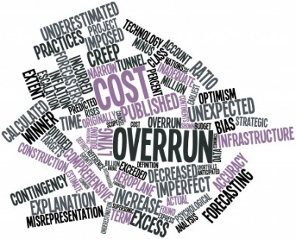
The Importance of Project Cost Management
IT projects have a poor track record for meeting budget goals.
Since 2003 CHAOS studies have showed the average cost overrun on IT projects ranges from 40% - 48% every year.
ECU Copyright 2015 – CSG 2344 School of Computer and Security Science

Slide 4
What is Cost and Project Cost Management?
Cost is a resource sacrificed or foregone to achieve a specific objective or something given up in exchange
Costs are usually measured in monetary units like dollars
Project cost management includes the processes required to ensure that the project is completed within an approved budget
ECU Copyright 2015 – CSG 2344 School of Computer and Security Science

Slide 5

What is Project Cost Management?
Project cost management includes the processes required to ensure that the project is completed within an approved budget.
ECU Copyright 2015 – CSG 2344 School of Computer and Security Science

Slide 6
Project Cost Management Processes
Cost estimating: Developing an approximation or estimate of the costs of the resources needed to complete a project.
Cost budgeting: Allocating the overall cost estimate to individual work items to establish a baseline for measuring performance.
Cost control: Controlling changes to the project budget.
ECU Copyright 2015 – CSG 2344 School of Computer and Security Science

Slide 7
Causes of Estimation Error
Misestimating the Project Scope
Misestimating the Stakeholders’ effort
Misunderstanding the Quality
Miscalculating the Project Risk
Forgetting tasks
Misunderstanding your people
Estimation is politics:
  The Low Bid
  The “buy the project” bid
  ➔ Most estimation errors occur before you estimate
ECU Copyright 2015 – CSG 2344 School of Computer and Security Science

Slide 8

Basic Principles of Cost Management
Most members of an executive board have a better understanding and are more interested in financial terms than IT terms, so IT project managers must speak their language.
ECU Copyright 2015 – CSG 2344 School of Computer and Security Science

Slide 9
Table 7-1. Cost of Software Defects
When the defect us detected | Typical Costs of Correction
User Requirements | $100 to $1000
Coding testing | $1000 or more
System testing | $10000 or more
Acceptance testing | Up to $100,000
After Implementation | Up to $1000,000
It is important to spend money up-front on IT projects to avoid spending a lot more later.
ECU Copyright 2015 – CSG 2344 School of Computer and Security Science

Slide 10
Cost Estimating
Project managers must take cost estimates seriously if they want to complete projects within budget constraints.
It’s important to know the types of cost estimates, how to prepare cost estimates, and typical problems associated with IT cost estimates.
ECU Copyright 2015 – CSG 2344 School of Computer and Security Science

Slide 11
Resource Planning
Some questions to consider:
  How difficult will it be to do specific tasks on the project?
  Is there anything unique in this project’s scope statement that will affect resources?
  What is the duration (eg annual pay increases, contractor rate reviews …)
  What is the organization’s history in doing similar tasks?
  Does the organization have or can they acquire the people, equipment, and materials that are capable and available for performing the work?
  What alternatives exist
    Outsourcing
    Contractors v permanent staff
  Costs – Contractors may cost more then staff in the long term
ECU Copyright 2015 – CSG 2344 School of Computer and Security Science

Slide 12

Cost Estimating
Project managers must take cost estimates seriously if they want to complete projects within budget constraints
It’s important to know the types of cost estimates, how to prepare cost estimates, and typical problems associated with IT cost estimates
ECU Copyright 2015 – CSG 2344 School of Computer and Security Science

Slide 13

Cost Estimation Considerations
The most significant cost of most IT Projects are labour costs
There are costs associated with the use of end-users
In most Projects there will be a need for varied skills, experience and other resources
Producing Project Cost estimates requires time, effort and commitment from ALL stakeholders
ECU Copyright 2015 – CSG 2344 School of Computer and Security Science

Slide 14

Types of Cost Estimates
ROM Rough Order of Magnitude
A “rough” idea of what the project will cost.
  Large range of accuracy or inaccuracy
  Dangerous basis for decision making
Budgetary Estimate
Used to allocate money into an organisation’s budget
  Usually more accurate but not always inclusive of all costs depending on budget policies
Definitive Estimate
  Accurate estimate used for decision making and inclusive off ALL project costs
  ➔ Often the best estimate is no estimate, particularly if you suspect the wrong use is to be made of the estimate
ECU Copyright 2015 – CSG 2344 School of Computer and Security Science

Slide 15
Estimation Principles
Avoid single person estimation
Always complete a risk assessment prior to estimation
Where possible use relevant experts
Always carefully document estimating assumptions
Review the Work Breakdown Structures
Always undertake Sensitivity Analysis
Beware the estimation ambush.
“I was so scared I heard my voice say 500 days.”
ECU Copyright 2015 – CSG 2344 School of Computer and Security Science

Slide 16
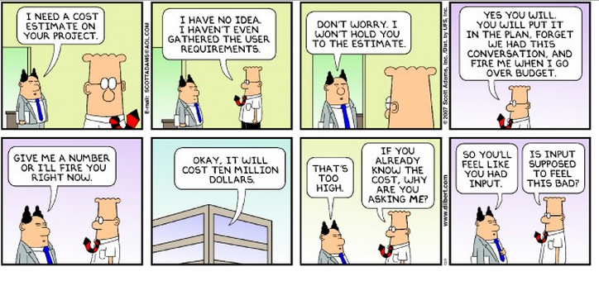
The Dangers of making a Guess

Slide 17
Other Costs to be Considered
Direct Costs
  Labour
  Materials, Equipment, Facilities
Indirect Costs
  Apportioned costs (eg administration contribution)
Sunk Costs – Costs already incurred
Learning Curve – time “lost” on learning new technologies required of the project
Contingency – a reserve in case something goes wrong – or based on risk assessment
ECU Copyright 2015 – CSG 2344 School of Computer and Security Science

Slide 18
Cost Estimation - Tools and Techniques
3 basic tools & techniques for cost estimates:
  analogous or top-down: use the actual cost of a previous, similar project as the basis for the new estimate
  bottom-up: estimate individual work items and sum them to get a total estimate
  parametric: use project characteristics in a mathematical model to estimate costs
ECU Copyright 2015 – CSG 2344 School of Computer and Security Science

Slide 19
Top Down Estimating
Uses the cost of previous similar projects
Requires good deal of expert judgement to understand where similarities and variations exist
Less costly to do
Less accurate
Relies on similarity of projects
Unless similarities are real and not perceived will lead to underestimation of the cost
ECU Copyright 2015 – CSG 2344 School of Computer and Security Science

Slide 20
Bottom Up Estimating
Involves estimating individual work items and summing to get total project cost
Size of individual work items and skill of estimators drives the accuracy
  The smaller the work item the more accurate the estimates are likely to be
Is time consuming and therefore costly to undertake
Often too focussed on effort rather than duration
ECU Copyright 2015 – CSG 2344 School of Computer and Security Science

Slide 21
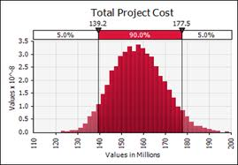
Parametric Modelling
Uses parameters for mathematical modelling
Parameters can include:
  Estimated lines of code
  Function points
  Corporate cost parameters (eg person cost of $10,000 per month)
Relies on historical data
ECU Copyright 2015 – CSG 2344 School of Computer and Security Science

Slide 22
Guestimating using Delphi Techniques
Provide team members with the required information
Review the Project Risk and Review the WBS
Individual estimation. Each person provides:
  Best case
  Worst case
  Likely case
Review first cut estimates
Undertake Delphi analysis – group discussion – issues considered, assumptions
Adjust estimates and Discard outriders
Final Reality check
ECU Copyright 2015 – CSG 2344 School of Computer and Security Science

Slide 23
Cost Management Plan
A cost management plan is a document that describes how the organization will manage cost variances on the project.
A large percentage of total project costs are often labor costs, so project managers must develop and track estimates for labor.
ECU Copyright 2015 – CSG 2344 School of Computer and Security Science

Slide 24
Cost Estimation Tools and Techniques
Basic tools and techniques for cost estimates:
  Analogous or top-down estimates: Use the actual cost of a previous, similar project as the basis for an estimation.
  Bottom-up estimates: Involve estimating individual work items or activities and summing them to get a project total.
  Parametric modeling: Uses project characteristics (parameters) in a mathematical model to estimate costs.
  Computerized tools: Tools, such as spreadsheets and project management software, that can make working with different cost estimates and cost estimation tools easier.
ECU Copyright 2015 – CSG 2344 School of Computer and Security Science

Slide 25
Typical Problems with IT Cost Estimates
Developing an estimate for a large software project is a complex task that requires a significant amount of effort.
People who develop estimates often do not sufficient experience or historical data
Human beings are biased toward underestimation.
Management might ask for an estimate, but really desire to win a major contract or get internal funding.
ECU Copyright 2015 – CSG 2344 School of Computer and Security Science

Slide 26
Cost Budgeting
Cost budgeting involves allocating the project cost estimate to individual work items over time.
The WBS is a required input for the cost budgeting process because it defines the work items.
Important goal is to produce a cost baseline:
  A time-phased budget that project managers use to measure and monitor cost performance.
ECU Copyright 2015 – CSG 2344 School of Computer and Security Science

Slide 27
Cost Control
Project cost control includes:
  Monitoring cost performance.
  Ensuring that only appropriate project changes are included in a revised cost baseline.
  Informing project stakeholders of authorized changes to the project that will affect costs.
Many organizations around the globe have problems with cost control.
ECU Copyright 2015 – CSG 2344 School of Computer and Security Science

Slide 28
Earned Value Management (EVM)
EVM is a project performance measurement technique that integrates scope, time, and cost data
Given a baseline (original plan plus approved changes), you can determine how well the project is meeting its goals
You must enter actual information periodically to use EVM
More and more organizations around the world are using EVM to help control project costs
ECU Copyright 2015 – CSG 2344 School of Computer and Security Science

Slide 29
Earned Value Management (EVM)
Earned Value represents the amount of the budget we really should have spent for the amount of work completed so far
In general terms:
  If the EV is greater than the actual cost we are in good shape ie we have spent less to achieve more
  If the EV is less than the actual cost we have spent more to achieve less ie we are not in good shape
ECU Copyright 2015 – CSG 2344 School of Computer and Security Science

Slide 30
Earned Value Considerations
To calculate the EV you need to know:
  What you had planned to complete by the calculation date:
    Cost estimates by task
    An accurate time schedule for each task
  The percentage complete of each task being included in the calculation:
    Often it is easier to work out how much time is still required to complete a task than estimate how much has been completed
    Beware the 90%n complete syndrome
ECU Copyright 2015 – CSG 2344 School of Computer and Security Science

Slide 31
Earned Value Management Terms
The planned value (PV), formerly called the budgeted cost of work scheduled (BCWS), aka the budget, is the approved total cost estimate planned to be spent during a given period
Actual cost (AC), also called actual cost of work performed (ACWP), is the total of direct & indirect costs incurred in accomplishing work on an activity during a given period
The earned value (EV), formerly called the budgeted cost of work performed (BCWP), is an estimate of the value of the physical work actually completed
EV is based on the original planned costs for the project & the rate the team is completing work on the project to date
ECU Copyright 2015 – CSG 2344 School of Computer and Security Science

Slide 32
Rate of Performance
Rate of performance (RP) is the ratio of actual work completed to the percentage of work planned to have been completed at any given time during the life of the project or activity
For example, suppose the server installation was halfway completed by the end of week 1; the rate of performance would be 50% because by the end of week 1, the planned schedule reflects that the task should be 100% complete and only 50% of that work has been completed
ECU Copyright 2015 – CSG 2344 School of Computer and Security Science

Slide 33
Using Software to Assist in Cost Management
Spreadsheets are a common tool for resource planning, cost estimating, cost budgeting, and cost control.
Many companies use more sophisticated and centralized financial applications software for cost information.
MS Project has many cost-related reports cash flow, budget, over budget tasks
ECU Copyright 2015 – CSG 2344 School of Computer and Security Science

Slide 34

Summary
Project cost management is traditionally a weak area in IT projects, and project managers must work to improve their ability to deliver projects within approved budgets.
Main processes include:
  Cost estimating
  Cost budgeting
  Cost control
ECU Copyright 2015 – CSG 2344 School of Computer and Security Science

